Slide 1
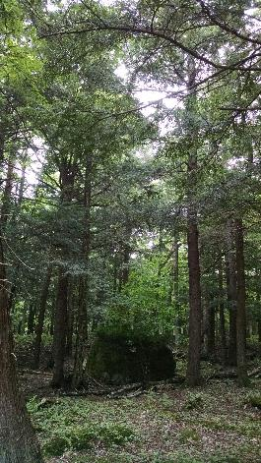
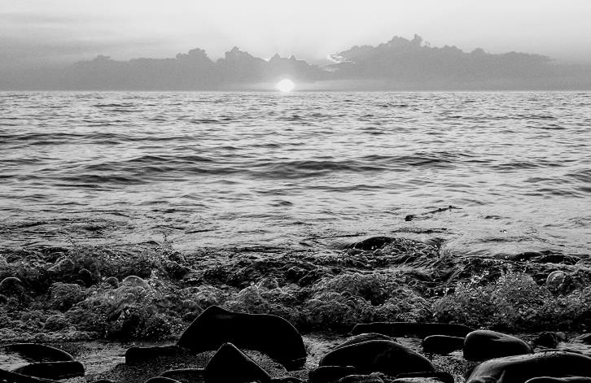
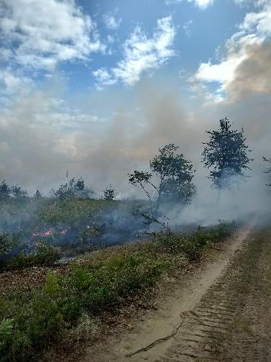
LANDFIRE
Application Examples in the Great Lakes
Randy Swaty – The Nature Conservancy’s LANDFIRE Team
Stepping in for Robert Zeil (aka “Zeke”) who is on fire assignment out west
September 22, 2020
Notes:
On behalf of the TNC LANDFIRE Team and the entire LANDFIRE Program, Kori and I thank you for the opportunity to present this webinar describing the status and plans for the LANDFIRE Program.

Slide 2
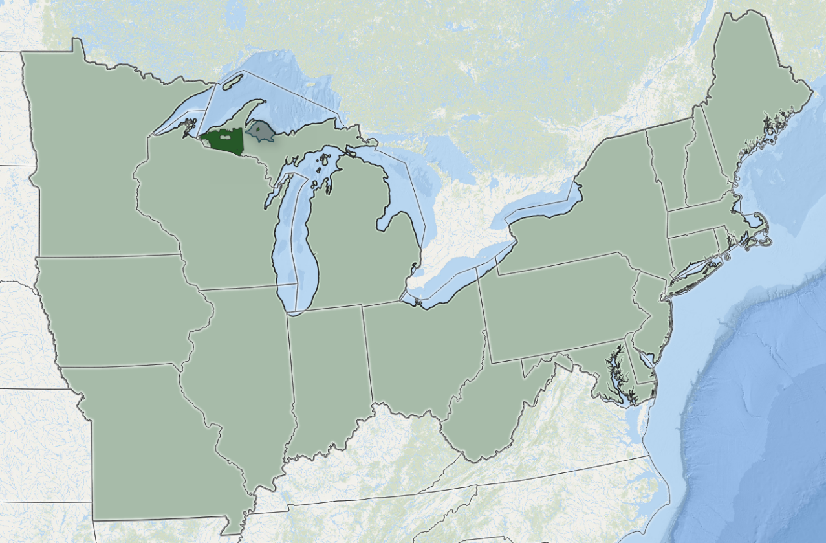
AGENDA
Three examples:
Basic vegetation Assessment-Ottawa National Forest
Regional Disturbance Investigation
Ecosystem condition mapping-Upper Michigan
Notes:
Review agenda

Slide 3
Rapid Landscape Assessment
Question: what ecosystems occurred/occur on the landscape, and what is the condition of these landscapes? What were their natural disturbance regimes?
How do we answer that with LANDFIRE Products?
Map LANDFIRE Biophysical Settings, Existing Vegetation Type and Succession Class Data
Use spreadsheets to help calculate and make charts
Optional- use R to make online report
What is a Biophysical Setting? A historical ecosystem with “natural” disturbance regimes, vegetation structure and composition
What is a Succession Class? A developmental state of a Biophysical Setting, defined by vegetation composition and structure (canopy cover and height)
Notes:
LANDFIRE is a partnership between the U.S. Forest Service and the U.S. Department of Interior, and TNC. On the left is a significant part of the LF Production team at EROS, and the right is the TNC team.

Slide 4
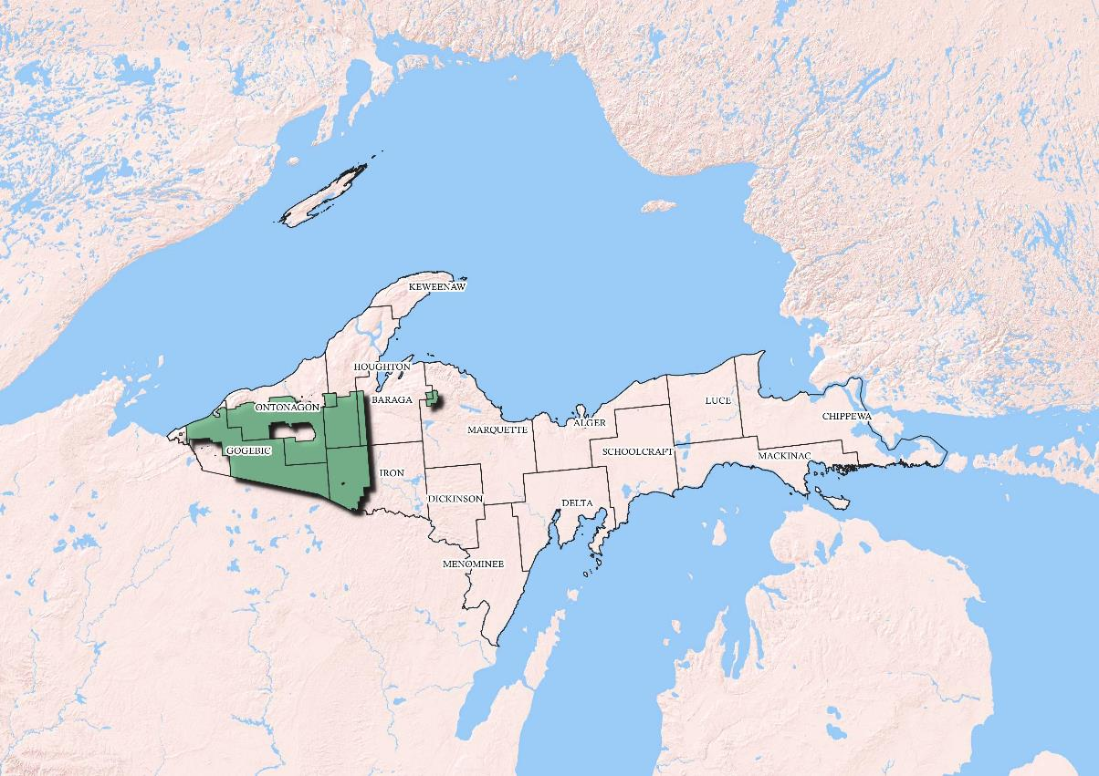
Rapid Landscape Assessment
Notes:
LANDFIRE is a partnership between the U.S. Forest Service and the U.S. Department of Interior, and TNC. On the left is a significant part of the LF Production team at EROS, and the right is the TNC team.

Slide 5
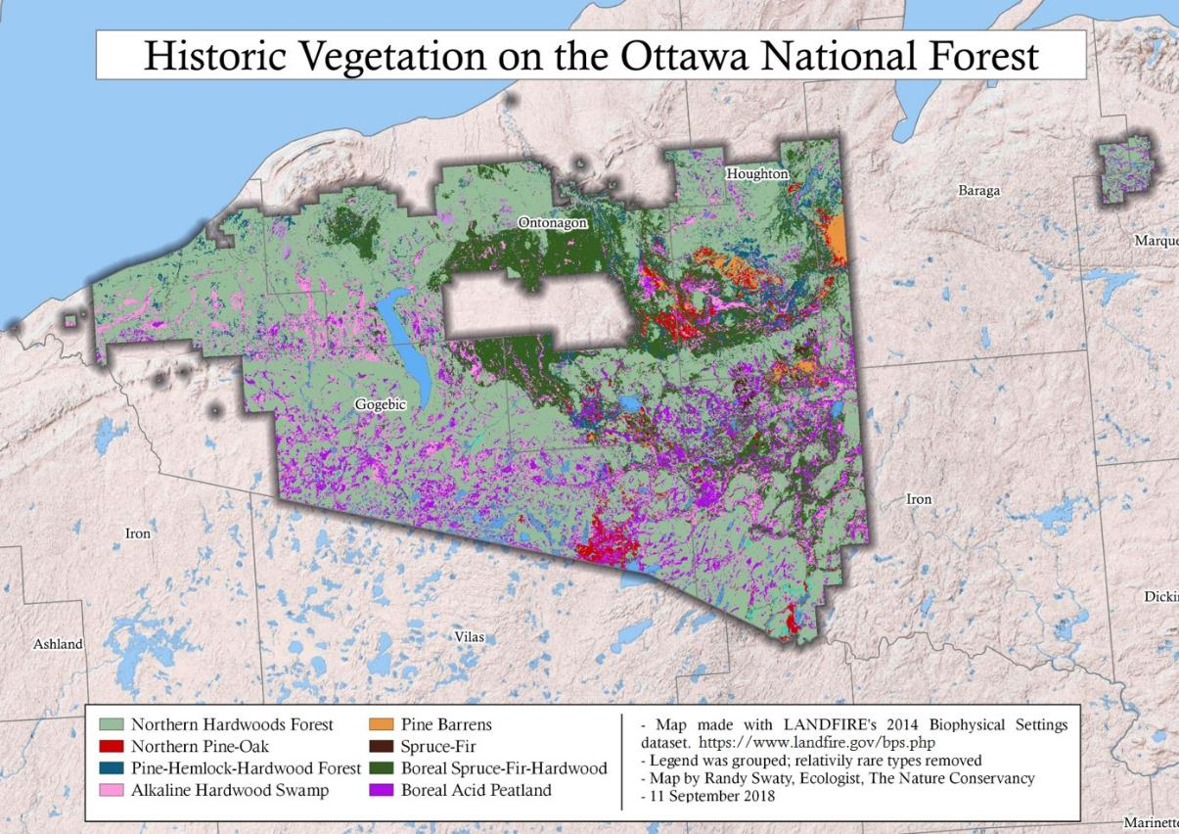
Rapid Landscape Assessment
Notes:
LANDFIRE is a partnership between the U.S. Forest Service and the U.S. Department of Interior, and TNC. On the left is a significant part of the LF Production team at EROS, and the right is the TNC team.

Slide 6
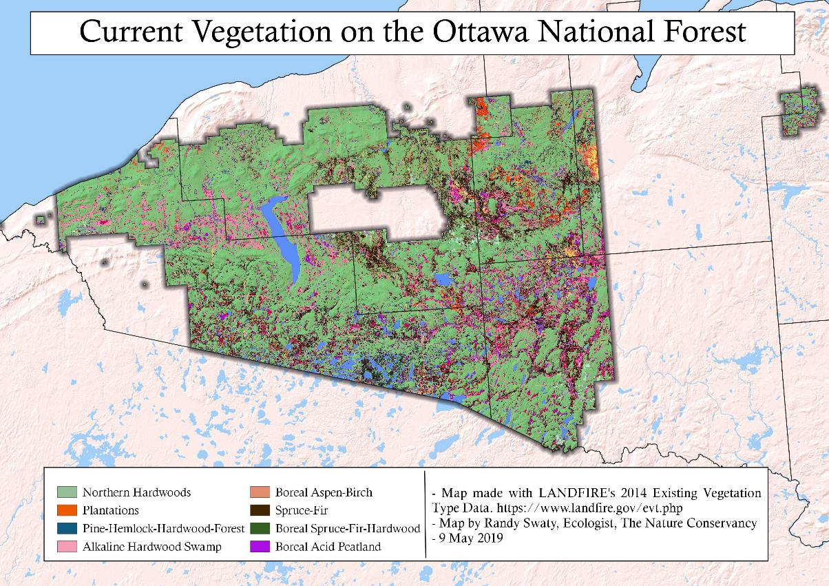
Rapid Landscape Assessment
Notes:
LANDFIRE is a partnership between the U.S. Forest Service and the U.S. Department of Interior, and TNC. On the left is a significant part of the LF Production team at EROS, and the right is the TNC team.

Slide 7
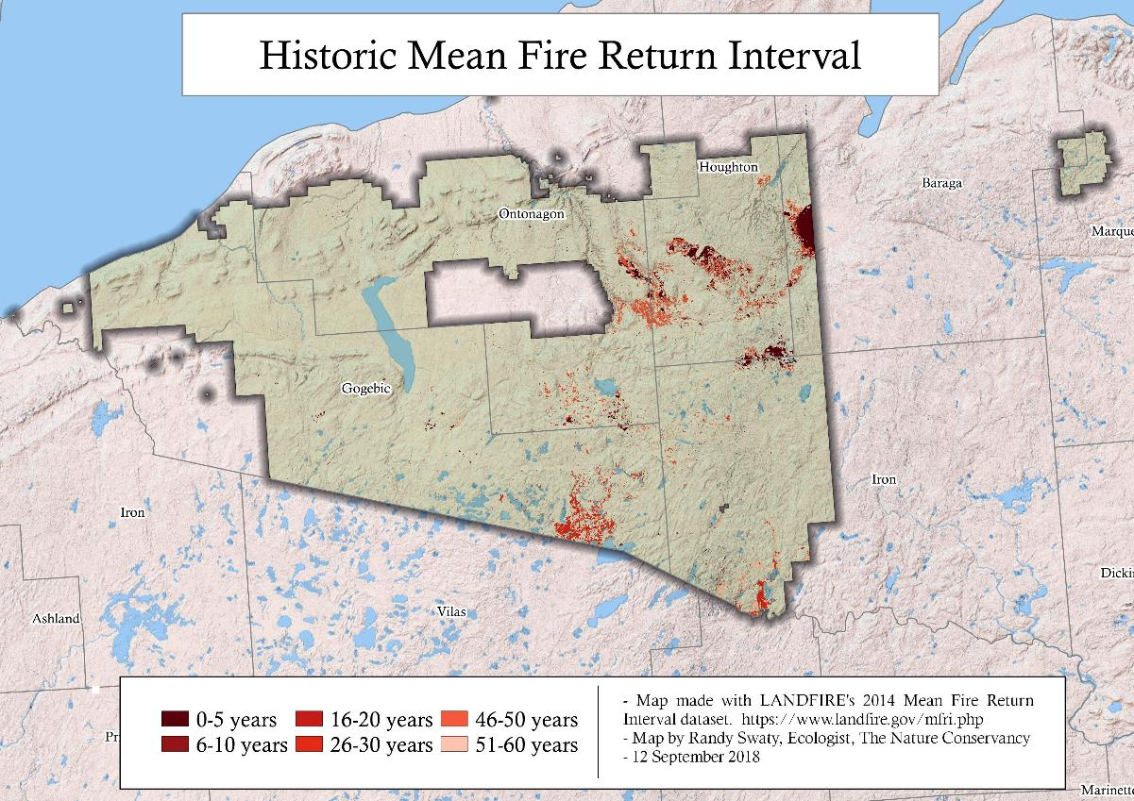
Rapid Landscape Assessment
Notes:
LANDFIRE is a partnership between the U.S. Forest Service and the U.S. Department of Interior, and TNC. On the left is a significant part of the LF Production team at EROS, and the right is the TNC team.

Slide 8
Rapid Landscape Assessment
Notes:
LANDFIRE is a partnership between the U.S. Forest Service and the U.S. Department of Interior, and TNC. On the left is a significant part of the LF Production team at EROS, and the right is the TNC team.

Slide 9
Rapid Landscape Assessment
Notes:
LANDFIRE is a partnership between the U.S. Forest Service and the U.S. Department of Interior, and TNC. On the left is a significant part of the LF Production team at EROS, and the right is the TNC team.

Slide 10
Rapid Landscape Assessment
Take away messages from this quick assessment:
While not dominated by fire-dependent ecosystems, fire does play a role, and other disturbances impact ecosystem condition and fire risk.
~14,000 acres burned annually
LANDFIRE data was useful in this quick assessment; Ottawa NF is investing in additional science to fill in knowledge gaps
Focused on proclamation boundary here-could extend to cover larger area
Explore the assessment at https://randy-swaty.shinyapps.io/OttawaAssessment/

Slide 11
Historical Fire in the Northeastern U.S.
Question: how much fire occurred annually prior to European Settlement (“natural” disturbance regime) in the northeastern region of the U.S.?
How do we answer that with LANDFIRE Products?
Use outputs from LANDFIRE Biophysical Settings models
Multiply outputs from models by acres of Biophysical Setting
What is a Biophysical Setting Model? A quantitative state and transition depiction of natural disturbance regimes and their impacts on the amount of succession classes on the landscape.
Quick made up example:
127,098 acres (of a BpS) X 10 year fire return interval = ~12,710 acres burned annually
(actually we multiply the acreage by the annual probability—1/10)
Calculations were for U.S.F.S Region 9-all lands except last slide in this section
Analysis kicked off by Anna Wright, volunteer.
Notes:
LANDFIRE is a partnership between the U.S. Forest Service and the U.S. Department of Interior, and TNC. On the left is a significant part of the LF Production team at EROS, and the right is the TNC team.

Slide 12
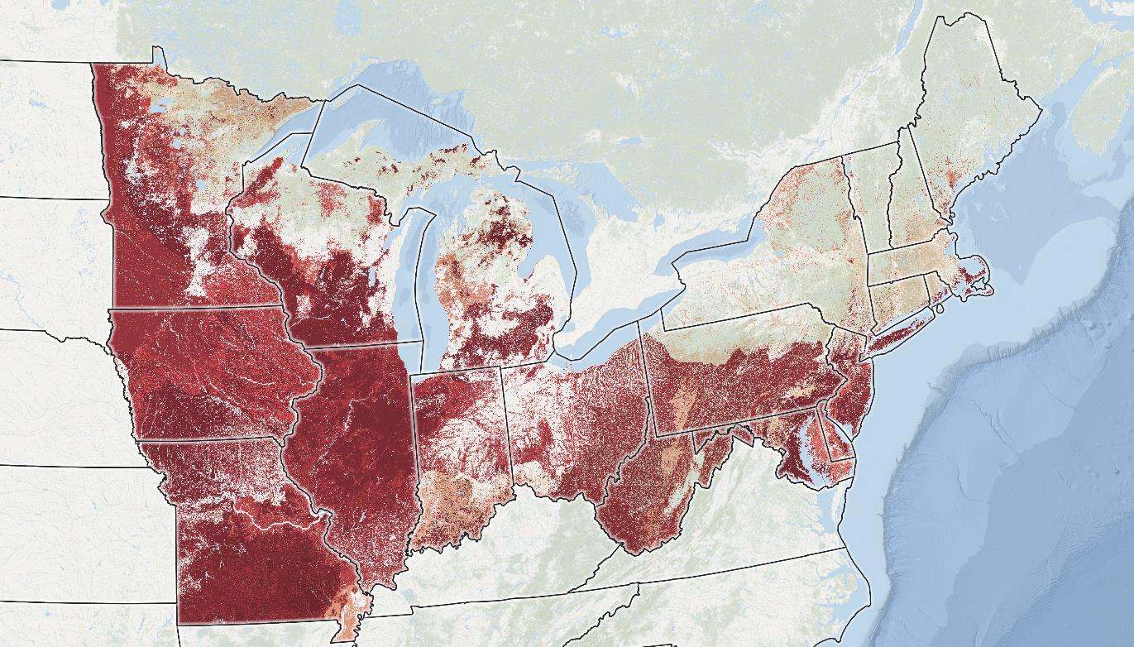
Historical Fire in the Northeastern U.S.
>
Historical Mean Fire Return Interval, from 1 (darkest reds) to >1,000 years (greens)
Notes:
LANDFIRE is a partnership between the U.S. Forest Service and the U.S. Department of Interior, and TNC. On the left is a significant part of the LF Production team at EROS, and the right is the TNC team.

Slide 13
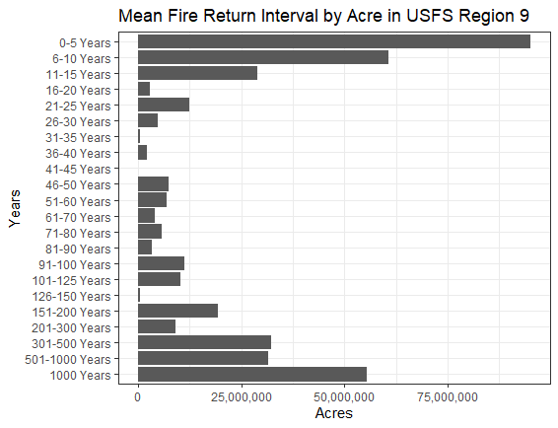
Historical Fire in the Northeastern U.S.
~420M acres total area
>
Notes:
LANDFIRE is a partnership between the U.S. Forest Service and the U.S. Department of Interior, and TNC. On the left is a significant part of the LF Production team at EROS, and the right is the TNC team.

Slide 14
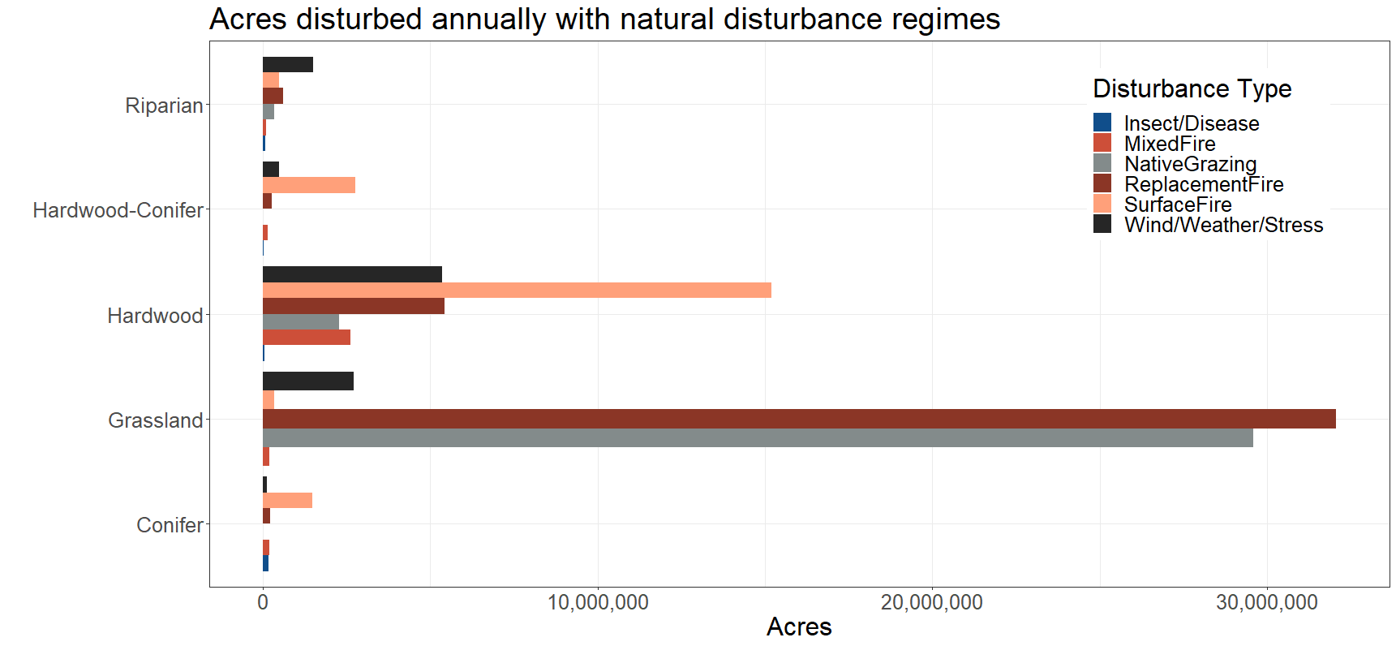
Historical Fire in the Northeastern U.S.
~30% of the northeastern U.S. was disturbed annually
Notes:
LANDFIRE is a partnership between the U.S. Forest Service and the U.S. Department of Interior, and TNC. On the left is a significant part of the LF Production team at EROS, and the right is the TNC team.

Slide 15
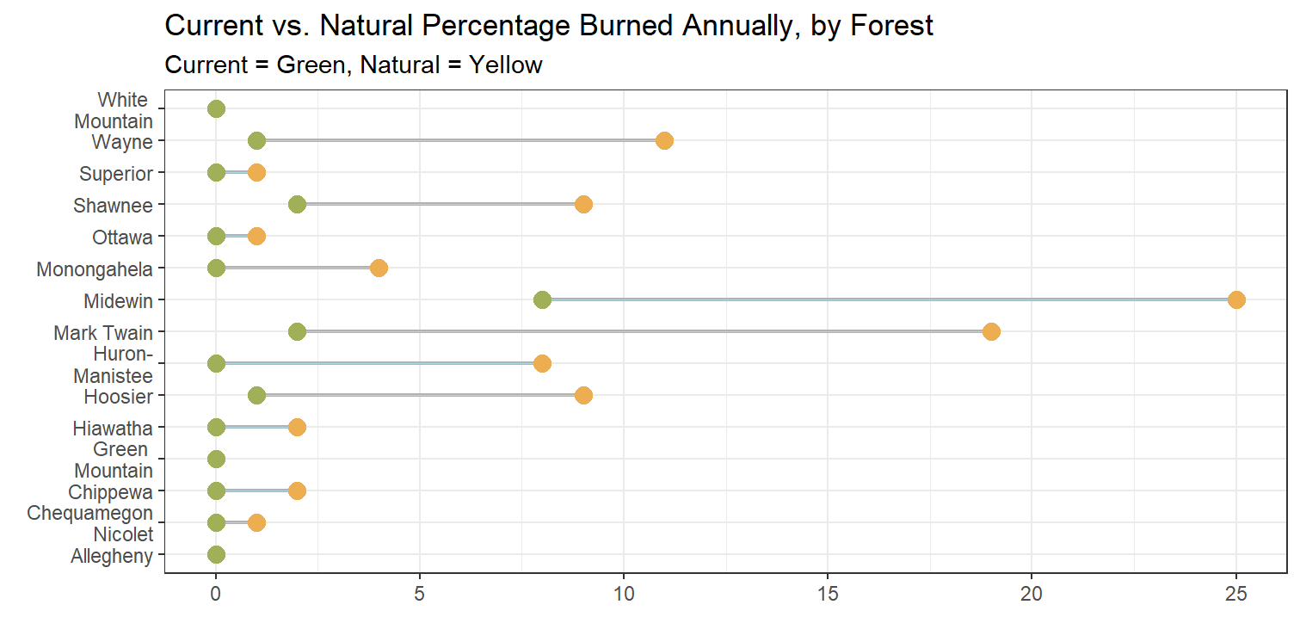
Historical Fire in the Northeastern U.S.
“Natural” adjusted by removing agricultural and urban lands
from calculation with LANDFIRE Existing Vegetation Type data.
Current data compiled by Brain Schaffler of USFS Region 9.
Notes:
LANDFIRE is a partnership between the U.S. Forest Service and the U.S. Department of Interior, and TNC. On the left is a significant part of the LF Production team at EROS, and the right is the TNC team.

Slide 16
Historical Fire in the Northeastern U.S.
Take away messages from assessment of historical fire regimes:
There was a lot of disturbance in the northeastern U.S. historically
Now what? We’ve lost most of the fire---there are consequences. LANDFIRE helps you to explore these, but does not give all the answers
I do not know of another dataset that allows this level of quantification of both historical disturbances across all lands.
Notes:
LANDFIRE is a partnership between the U.S. Forest Service and the U.S. Department of Interior, and TNC. On the left is a significant part of the LF Production team at EROS, and the right is the TNC team.

Slide 17
How much of any one ecosystem is degraded?
Question: how much of the northern hardwoods ecosystem of the Upper Peninsula of MI is degraded?
How did we assess this? We basically developed a “simple starter ruleset” to label levels of degradation of northern hardwood forest habitat.
We then added LANDFIRE datasets together:
Biophysical Settings
Existing Vegetation Type, Cover and Height
Followed by filtering for the various combinations in Excel and mapping.
Notes:
LANDFIRE is a partnership between the U.S. Forest Service and the U.S. Department of Interior, and TNC. On the left is a significant part of the LF Production team at EROS, and the right is the TNC team.

Slide 18
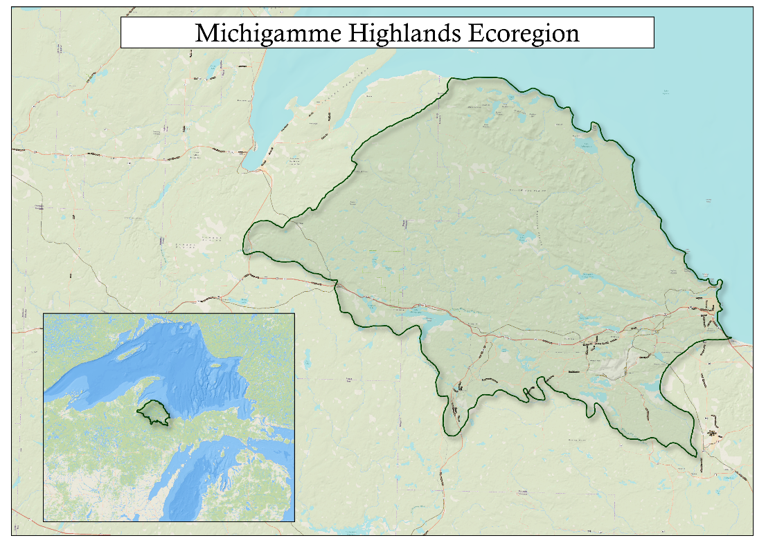
How much of any one ecosystem is degraded?
The landscape is a mix of state, federal and private (industrial and family) ownerships
Notes:
LANDFIRE is a partnership between the U.S. Forest Service and the U.S. Department of Interior, and TNC. On the left is a significant part of the LF Production team at EROS, and the right is the TNC team.

Slide 19
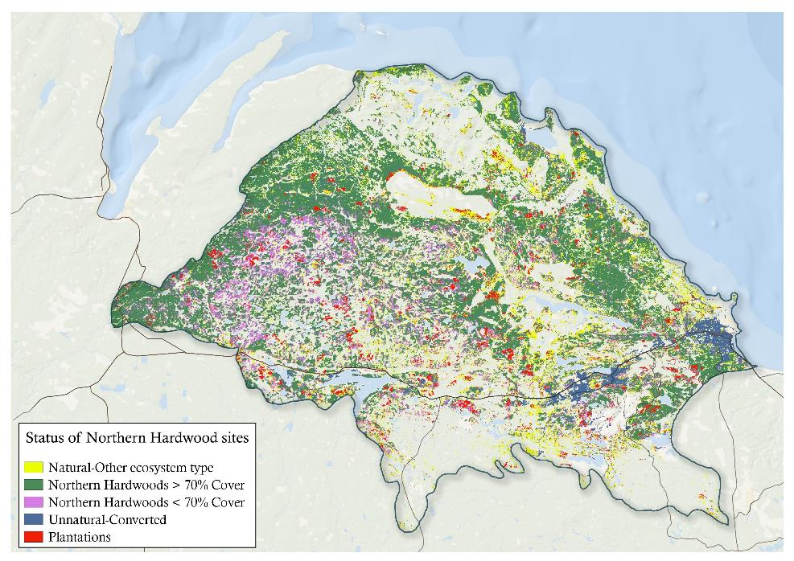
How much of any one ecosystem is degraded?
For this work any Northern Hardwood site that is currently a different ecosystem or has < 70% canopy cover is assumed to be degraded and may need more assessment.
Notes:
LANDFIRE is a partnership between the U.S. Forest Service and the U.S. Department of Interior, and TNC. On the left is a significant part of the LF Production team at EROS, and the right is the TNC team.

Slide 20
How much of any one ecosystem is degraded?
Take away messages from mapping condition of northern hardwoods:
There is a wide range of condition, from totally converted to near natural
A relatively simple ruleset combined with LANDFIRE data helps land managers estimate potential restoration investment needed
Many researchers and managers have used this approach to map wildlife habitat, restoration priorities, vegetation conditions and more.
Notes:
LANDFIRE is a partnership between the U.S. Forest Service and the U.S. Department of Interior, and TNC. On the left is a significant part of the LF Production team at EROS, and the right is the TNC team.

Slide 21
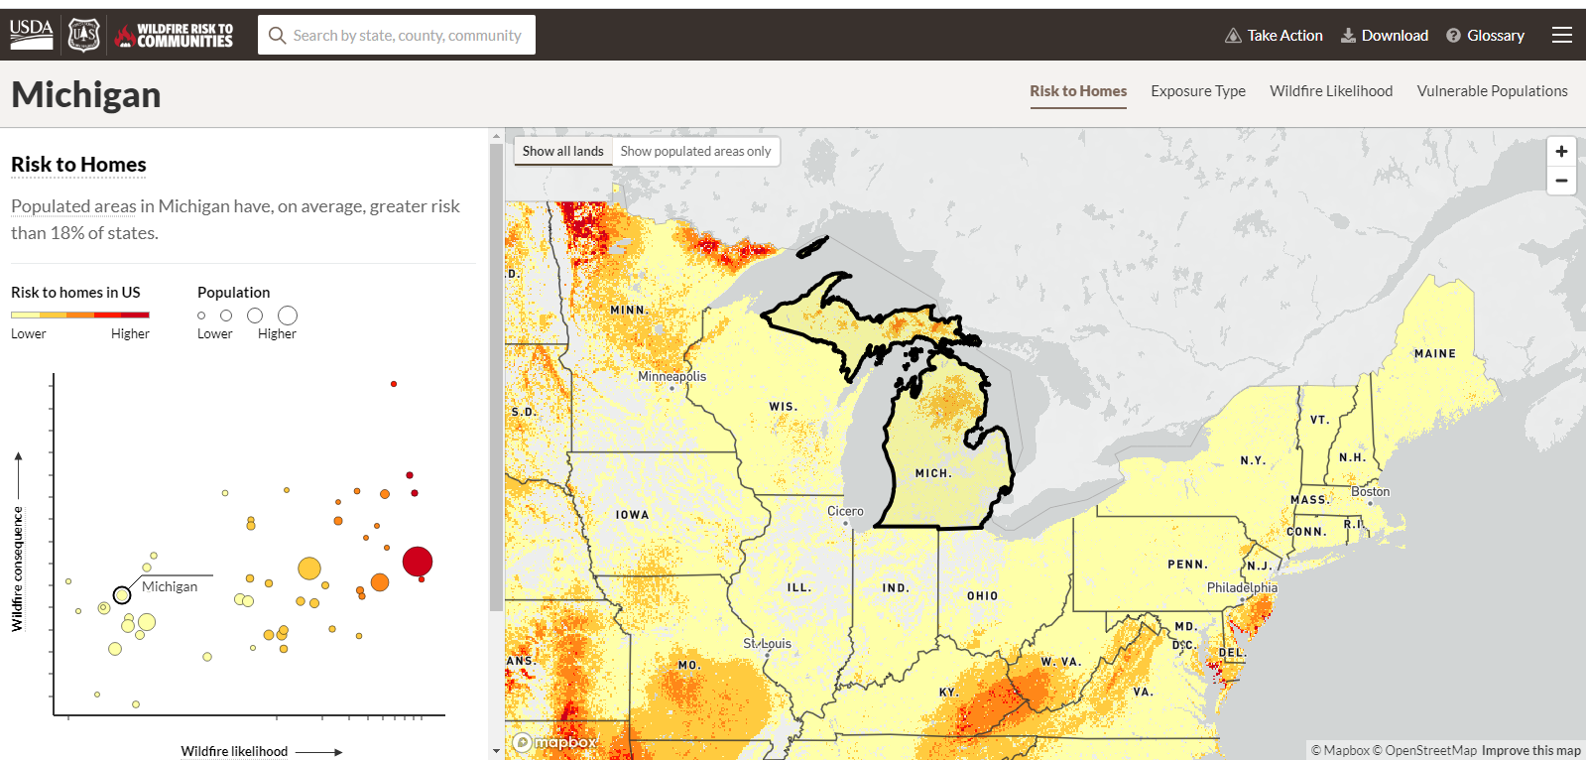
Other examples of LANDFIRE applications
https://wildfirerisk.org/
Notes:
LANDFIRE is a partnership between the U.S. Forest Service and the U.S. Department of Interior, and TNC. On the left is a significant part of the LF Production team at EROS, and the right is the TNC team.

Slide 22
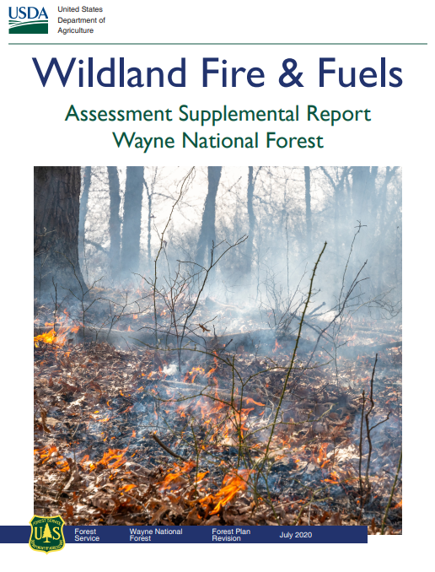
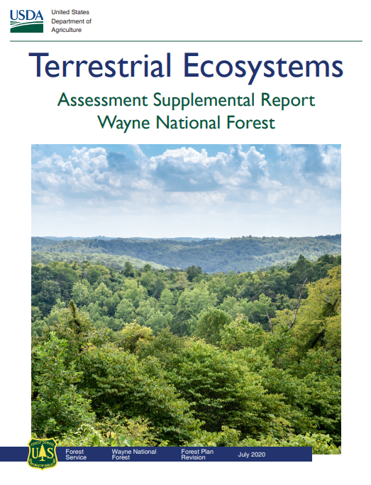
Other examples of LANDFIRE applications
Notes:
LANDFIRE is a partnership between the U.S. Forest Service and the U.S. Department of Interior, and TNC. On the left is a significant part of the LF Production team at EROS, and the right is the TNC team.

Slide 23
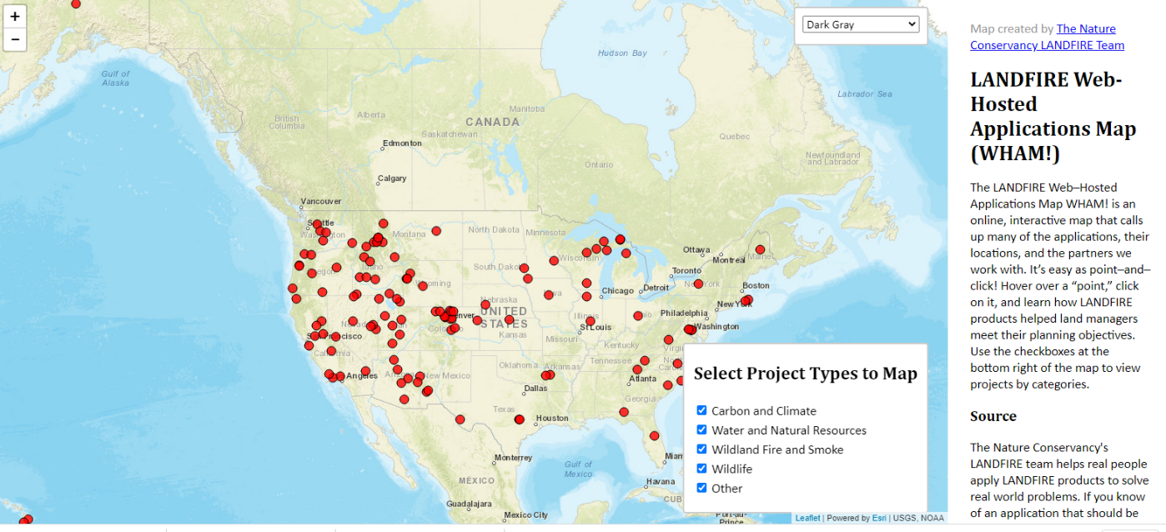
Other examples of LANDFIRE applications
Explore the WHAM! at http://maps.tnc.org/landfire/
Notes:
LANDFIRE is a partnership between the U.S. Forest Service and the U.S. Department of Interior, and TNC. On the left is a significant part of the LF Production team at EROS, and the right is the TNC team.

Slide 24
For your LANDFIRE application(s)
If LANDFIRE is new to you, or you want to learn more:
www.landfire.gov
Explore and download datasets
Learn about the program and updates
Find podcasts and social media links
Send feedback
Review any and all data. See Helmbrecht, Donald J. and Kori Blankenship. 2016. Modifying LANDFIRE Geospatial Data for Local Applications.
We are on Twitter and YouTube
Explore the WHAM! at http://maps.tnc.org/landfire/
Contact us!
On landfire.gov
landfire@tnc.org
Any of the presenters in this series
Notes:
LANDFIRE is a partnership between the U.S. Forest Service and the U.S. Department of Interior, and TNC. On the left is a significant part of the LF Production team at EROS, and the right is the TNC team.

Slide 25
For your LANDFIRE application(s)
If LANDFIRE is familiar but you want to try new things:
We have R code for processing rasters, making charts and web apps
Try running the LANDFIRE Total Fuels Change Tool to calibrate fuels data to for localized scales
Dig into Google Scholar
Notes:
LANDFIRE is a partnership between the U.S. Forest Service and the U.S. Department of Interior, and TNC. On the left is a significant part of the LF Production team at EROS, and the right is the TNC team.

Slide 26
Questions?
I’ve got some questions for you:
Do you have a LANDFIRE application to share?
Which LANDFIRE datasets do you use the most?
Can we clarify anything about LANDFIRE data or model use for you?
Notes:
LANDFIRE is a partnership between the U.S. Forest Service and the U.S. Department of Interior, and TNC. On the left is a significant part of the LF Production team at EROS, and the right is the TNC team.

